Slide 1



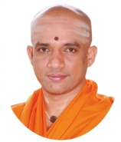
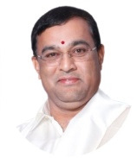


|| Jai Sri Gurudev ||
Sri Adichunchanagiri Shikshana Trust®
SJB INSTITUTE OF TECHNOLOGY
Department of Electronics & Communication Engineering
Review-1 - Mini-Project (18ECMP68) Presentation on
An Improved Novel Approach to QIP Security Technologies on the FRQI and NEQR QIR models
Batch 3
Presented By
Arun R 1JB19EC102
Koushik Kumar B 1JB19EC036
Nivendu Tripathy 1JB19EC063
Dinanshu Biswas 1JB19EC026
Under the guidance of
Dr. Rekha K.R
Professor
Dept. of ECE, SJBIT

Slide 2
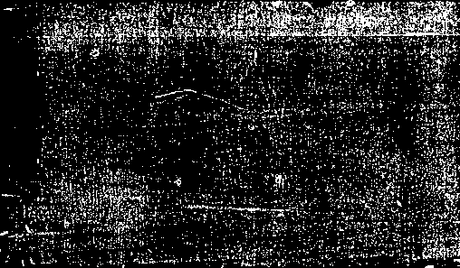


CONTENTS
1.Abstract
2.Introduction
3.Literature Survey
4.Motivation and Challenges
5.Problem Statement
6.Objectives
7.Proposed Methodology
8.Tools Used
9.Expected Outcome
10.Applications
12.References
11.Project Timeline

Slide 3

Keywords
Quantum Computing, Quantum Image processing, Qubit, Quantum Superposition, Quantum Noise, Quantum Image Representation
quantum watermarking; quantum image encryption; quantum image steganography

Slide 4

ABSTRACT
In this project we first enable the conversion of image data to sound using pseudo Hilbert curve on python, and perform sampling, quantizing, and parity check bits ordering to get the original image back.
In the next section, proposed methodology …….
Then we deal with transmission of text using frequency encoding of ascii values , audio using conventional techniques and image on a sound using air and water as the medium
In addition, we see the real time applications of ……

Slide 5

INTRODUCTION
The digital divide between urban and rural areas is now attracting active research. There are a host of reasons for this divide and this paper presents the work in progress about one proposed solution to a major technical problem causing this. It has been noted that the high frequency WiFi and similar signals are not well suited for the wilderness type of environment with dense foliage. Additionally, such terrains also impose stringent restriction on computational and electric power as well as in cost. This calls forth the need for a new type of signal that can work efficiently in such environments and a low cost, low bandwidth, low frequency signal that can possibly work is identified in the form of Sound. This paper presents a new network architecture that is designed to work with the low frequency, ubiquitous signals such as sound. The architecture can work in peer-to-peer ad-hoc networks mode, infrastructure mode, broadcast mode (for remote telemetry) etc. using wideband multi-channel transmission. However, since the proposed architecture uses low frequency signal, it is expected to deliver low throughput as well. Using an ubiquitous signal such as sound makes the entire process very cost effective as it eliminates the need of expensive transceivers. There is an ever growing technological divide between the urban and rural technological framework. We see the urban front growing in leaps and bounds, fueled by the large economic resources and wide user base, resulting in improvements in speed, reliability and cost. The rural environment does not have these financial resources, and with some added technological limitations that makes it almost impossible to adopt the urban technologies leaves this front struggling to establish basic minimal connectivity. This divide is not conductive for total economic and social development and progress of the world at large and therefore research in this front is of paramount importance. The terrain and sparse user base of the jungle type of environment makes it extremely ineffective to set up wired infrastructure for network connectivity and hence the better option in terms of cost effectiveness and reach is using wireless. However, the dense growth of bushes drastically reduces the range of high frequency RF signals used by WiFi, 3G etc. These are also high energy signals, greatly depreciating the usability as the terrains pose serious limitations to the rages of these signals. It is therefore desirous to have a low energy, low frequency, ubiquitous signal. Sound is a good candidate for such requirements, given its ubiquitous presence, low energy and low frequency, allowing it to traverse very well over obstacles. However, the ubiquity of sound also leaves us open to handle a lot of “noise” as well. The previous studies have analyzed and proven that sound can be used as a carrier signal for wireless data communication, studied the noise profiles in various environment to gather idea on efficient signal-to-noise ratios and to aid identification of appropriate channels for communication, and a survey to identify sound perception of various frequencies by humans so that the channel used for data transmission causes minimal intrusion to the environment of use. This paper furthers with the architecture for a model designed for the purpose. The ensuing sections of the paper is organized as related works, the proposed signal (sound), the design, its philosophy and application and conclusion and future Works. Advances in communication technology have made it easier and faster to share and/or transfer information. High volumes of data can be communicated through data transmission systems such as a local or wide area network (for example, the Internet), a terrestrial communication system or a satellite communication system. These systems require complicated hardware and/or software and are designed for high data rates and/or long transmission ranges. For transfers of data at close proximity or short distances, such as between a personal computer and personal data assistants (PDAs), the systems above may be an inconvenient communication medium for users because of the complexity, delay and often the cost involved in accessing the systems.
Accordingly, other communication systems have been developed using communication medium such as radio frequency (RF) or Infrared (IR) to transmit data. However, these systems require specialized communication hardware and/or interfaces, which can often be expensive and/or impractical to implement. Non-wireless connections can also be used to transfer data. However, to use non-wireless types of connections, users must physically have as well as carry wires or cables and make the physical connections for communication. This can be burdensome and inconvenient to users. Therefore, there is need for a less complex, yet user-friendly, inexpensive and/or efficient way to share and/or transfer information

Slide 6
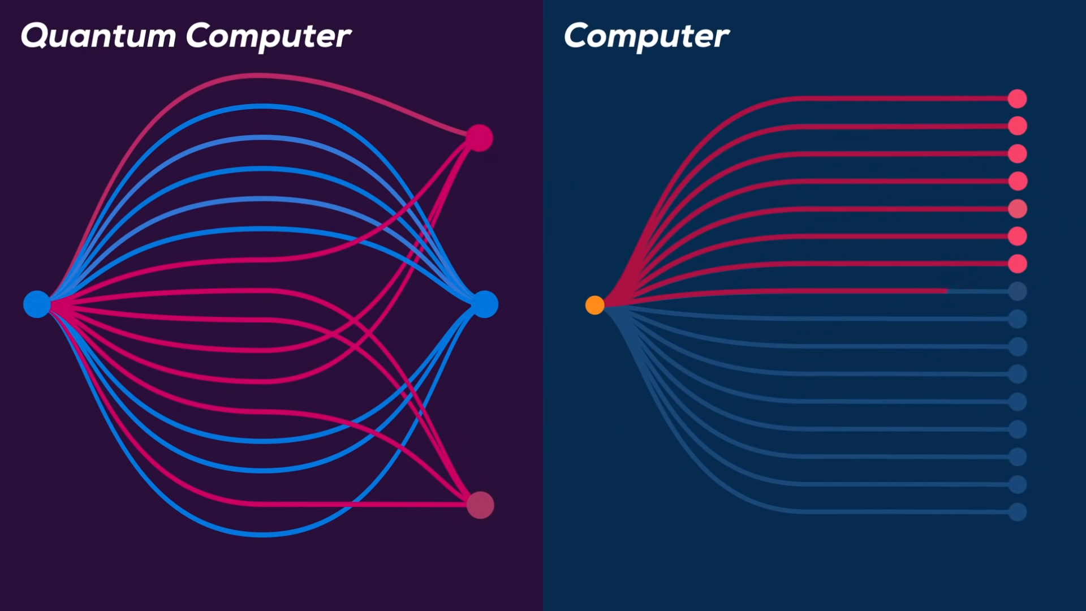

Slide 7

Literature survey
AUTHORS AND TITLE | CONCEPTS OR IDEAS DISCUSSED | LIMITATION
‘Quantum Image Processing - Challenges and Future Research Issues’ by Sanjay Chakraborty, Sudhindu Bikash Mandal and Soharab Hossain Shaikh A.K.Choudhury School of Information Technology,University of Calcutta, Kolkata, India and Computer Science and Engineering, BML Munjal University, India | This survey gives overview information about progressive techniques and methods in the field of QIP | L: After encoding, the operators is used as QFT, which is inconsistent with multichannel image processing
‘An improved novel quantum image representation and its experimental test on IBM quantum experience’ by Jie Su, XuchaoGuo , Chengqi Liu , Shuhan Lu & Lin Li College of Information and Electrical Engineering, China Agricultural University, Beijing 100083, China. Master of Health Informatics, School of Information, University of Michigan, Ann Arbor, MI 48109, USA | This paper dealt with the objective and experimental overview of existing QIR models and attain a more encryption based technologies, like stenography, quantum watermarking extracted by QFTs | L: It basis its final model on NCQI representation technique which restricts to 1:1 matrix, and thus is inconsistent with vertical and horizontal positioning
‘Image Processing In Quantum Computers’ by Aditya Dendukuri and Khoa Luu Computer Vision and Image Understanding Lab Computer Science and Computer Engineering Department, University of Arkansas, Fayetteville, AR, 72701 | A general review on all the advancements in the given field | L:the paper is based on 2^n bits , while quitrits and log23n is an existing technology.

Slide 8
Motivation
Communication systems have been developed using communication medium such as radio frequency (RF) or Infrared (IR) to transmit data. However, these systems require specialized communication hardware and/or interfaces, which can often be expensive and/or impractical to implement.
It has been noted that the high frequency WiFi and similar signals are not well suited for the wilderness type of environment with dense foliaCursive handwriting makes the separation and recognition of characters challenging.
Underwater communication is still a big challenge due to the oceanic environment physical characteristics.
The project has an immense potential in military applications from data communication(text, audio , image, video) without internet to industrial production setups to sensing of foreign aliens.

Slide 9
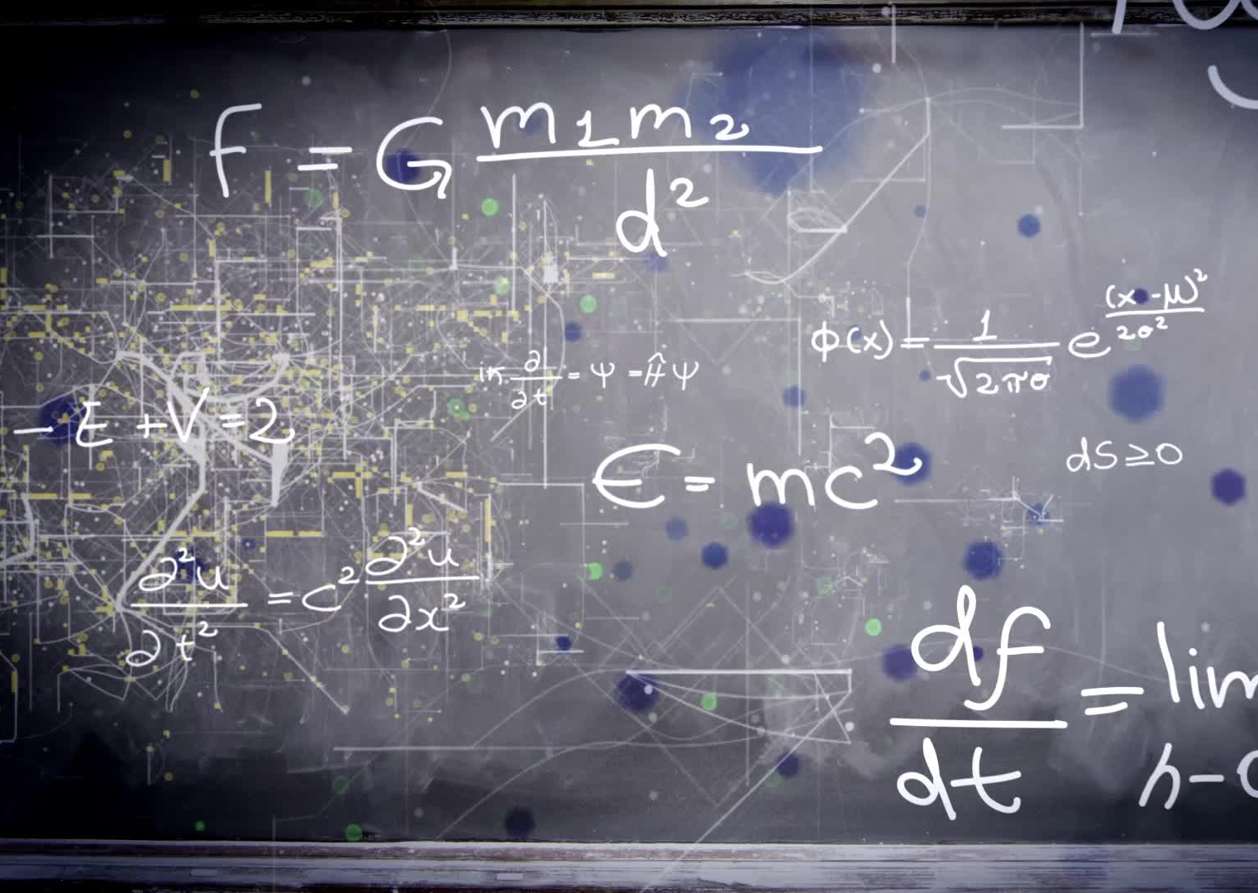
Challenges
Difficult to transmit sound over large distances.
Degradation and dampening of sound with terrain change.
Only 64x64 px image can be converted to sound, any higher or lower it creates interference with intended application.
Conversion of image and video data is taking 10 -30min.

Slide 10

Problem STATEMENT
As we all know, there is a tight dependency from one part of an image to other parts. Maintaining this correlations between different points of an image are very important in order to properly understand and describe the image. Storing of an image in classical computers may lose such relevant information, because it needs information about the relationship between stored color values (or gray-scale) and corresponding pixels locations. Quantum computer can store color values (or gray-scale) and corresponding pixels locations of an image using the concept of quantum registers

Slide 11

OBJECTIVES
To convert the images to sound and vice versa.
To encode, encrypt and emit the data (text, audio, image, video) over handheld transrecievers

Slide 12
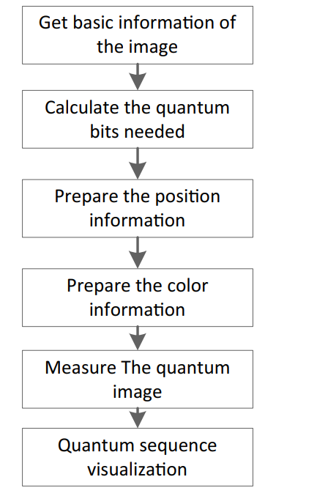
Proposed Methodology
1. Get basic information of the image : we mainly analyze the processed grayscale image to obtain its basic information. Defining the image to be processed as F to facilitate subsequent representation. F has a total of 8 grayscale pixels, each of which ranges from [0,255]. Ten, the gray level information of F is converted into a binary digit size of 8, the width information n1 is 1, and the length information n2 is 2
2. Calculate the quantum bits needed To corresponding quantum bits are set according to the basic information of the image obtained in the previous step. Grayscale information requires 8 qubits, and position information requires 3 qubits.
3. Prepare the position information : H gate transformation is performed on the position quantum bit to prepare position information according to the preparation process of the quantum image of the INCQI. The H gate transformation is carried out for the three quantum bits in the position information of F, and the superposition state of the eight components is obtained, which is expressed as follows. the first 3 bits of each quantum bit in represent the position information and the last 8 bits represent the grayscale information. Besides, the position information is obtained in this step using only the H-gate, while the grayscale information remains zero

Slide 13
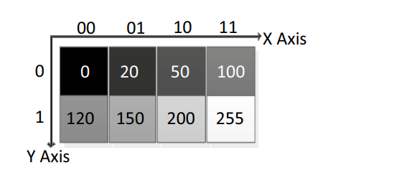
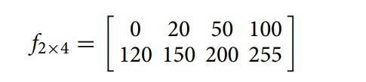
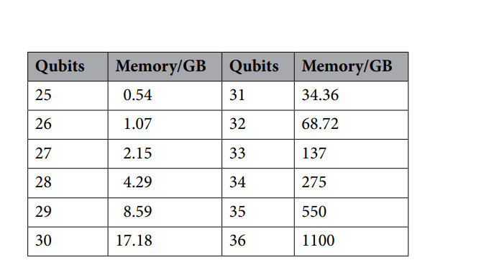
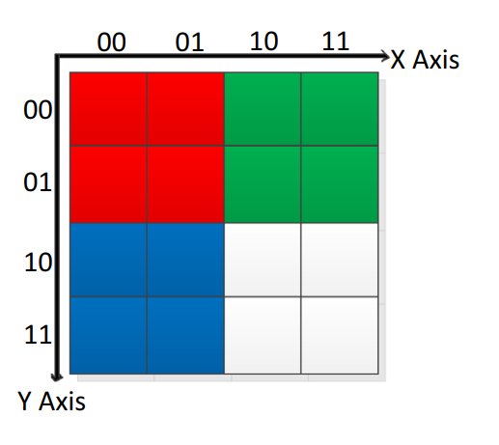
Prepare the color information According to the grayscale information of each pixel in F, it is converted into the corresponding quantum sequence in turn to realize the unique mapping process of grayscale information and position information
Measure the quantum image Te INCQI stores the grayscale information and position information in the classical image F in the superposition state of the quantum sequence, and by the measurement operation of each quantum bit, the quantum grayscale image system will collapse and fnally output the position information and grayscale information of each pixel in the form of probability amplitude

Slide 14
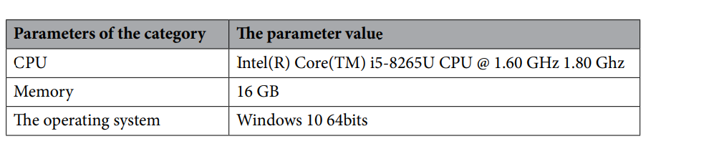
Hardware & Software to be used
Library:
QETLAB
QISKIT
Open Fermion
Strawberry fields
Environment:
MATLAB
Python
Hardware:
IBM Quantum System One
127 qubit Eagle family processor
16 qubit optimised2D lattice canary family processor
Web GUI
IBMQ Cloud Platform

Slide 15
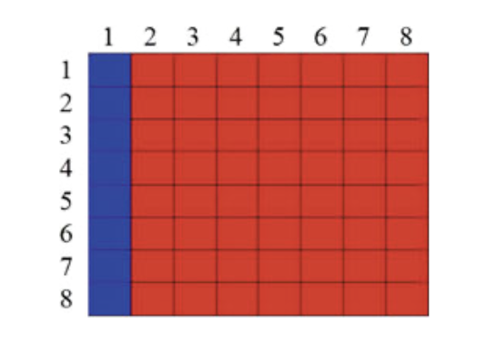
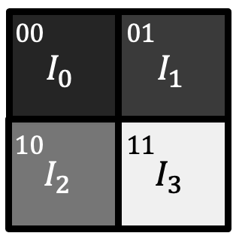
Expected outcome
.
Images, text and audio are transmitted on sound waves in wireless comms architecture.
Images are converted to sound and make them non detectable to sensors.
Network sniffing and packet tracing is not detected in the case of sound waves , to ensure a secure transmission of data .

Slide 16
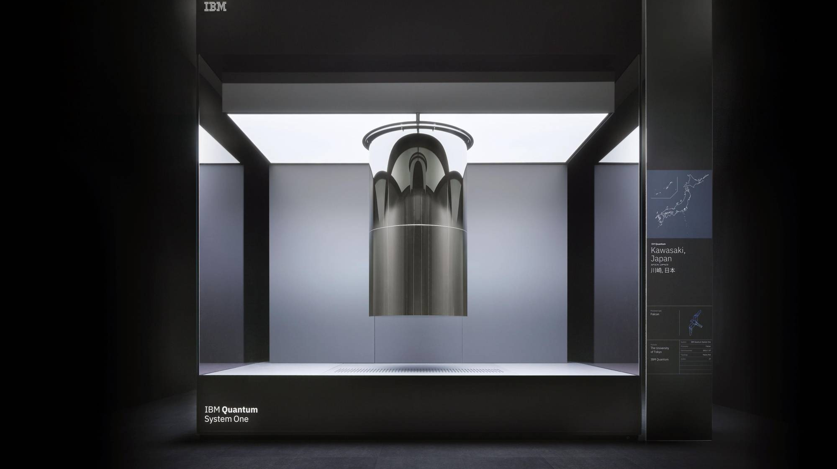
Application
Quantum Noise reduction from medical images is a big issue now a days. It is generated due to improper distribution of photons (pixels) over the receptor plane and the quantum noise can be reduced by increasing the concentration of photons over the plane. We can use any special technique which can deal with the density of the pixels of an image and also apply some density distribution technique to reduce the quantum noise.
Quantum computing and quantum information processing may play a key role in military applications. As for example, quantum radar can be built using the concept of quantum image processing algorithm (QIMP) In the fields of astrophysics bioinformatics, and nanotechnology etc, QIMP contribute toward solving open challenges in image processing
According to paper ,the approach is bounded by the main 3 types of image processing operators are used based on the concept of quantum Fourier transforms.The investigation on each of three types of image processing operations can also be applied on the quantum Wavelet transform,the quantum discrete cosine transform, etc. The mentioned approach directions are all on a single image. There are interesting questions on quantum operations having impacts on multiple images such as image matching, image searching on a set of images in FRQI states. These directions may open new results on quantum image processing in general.
According to paper ,in future such a neural filter can be made which perform the mathematical analyses on the statistical properties of the quantum noise and on the removal of noise using NNs. Using this approach, various kinds of NN models such as radial basis function networks etc. can be handled in future, especially problems like the Travelling Saleman.
Quantum image cryptography is one of the areas where we can apply the different features of quantum computing to get more compressed image which is suitable for storing and transformation
Image processing can be exploited in a multivalued quantum system with more benefits than a binary valued quantum system. As a future research scope,one can represents images (specially color images) in a n-qutrit quantum system by a superposition of 3n basis states, thus a quantum register of size n can hold 3n values simultaneously, whereas an n-qubits register can only hold only 2n values. So it actually provides more dimensions in the Hilbert space to store large size of color images efficiently compare to the binary system

Slide 17





Project Timeline Template
STAGE 01: 15th April 2022
Finalizing and hypothesizing the INCQI model , running AER simulations to get quality and coded histograms
STAGE 02: 23rd April 2022
STAGE 04 :14th May 2022
STAGE 05: 15th May 2022
First Project Review
Analyzing the crtiques, and working on implementing the code to have real time simulations based on IBMQ eagle processor
Analyzing existing problems in classical DIP and forming effective solutions
Importing IBMQ Cloud platform and running simulations on FRQI and NEQR models
STAGE 03: 5th May 2022
STAGE 06: 25th June 2022
Additional Stage 01
Additional Stage 02
Additional Stage 03

Slide 18
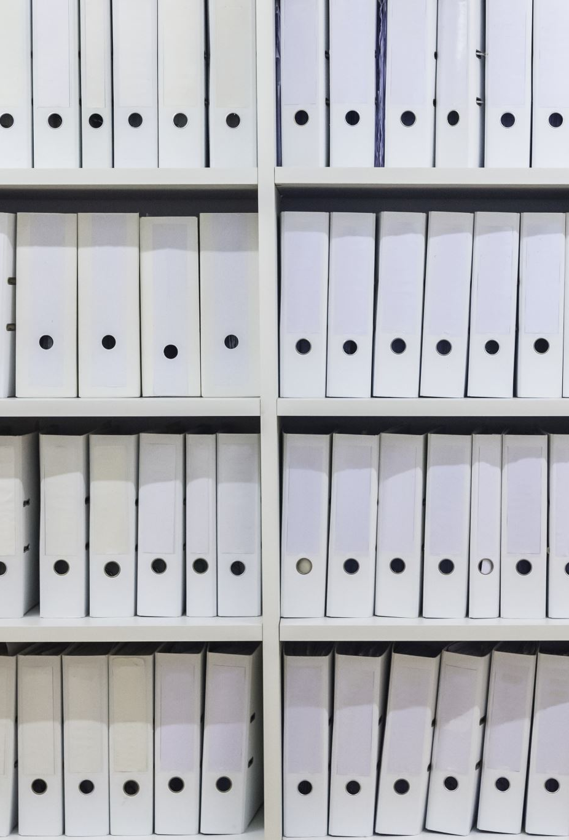
References
Qasem, Z.A.; Esmaiel, H.; Sun, H.; Wang, J.; Miao, Y.; Anwar, S. Enhanced fully generalized spatial modulation for the internet of underwater things. Sensors
Said, A.; Pearlman, W.A. A new, fast, and efficient image codec based on set partitioning in hierarchical trees. IEEE Trans. Circuits Syst. Video Technol. 1996
Jeganathan, J.; Ghrayeb, A.; Szczecinski, L. Generalized space shift keying modulation for MIMO channels. In Proceedings of the 19th International Symposium on Personal, Indoor and Mobile Radio Communications, Cannes, France, 15–18 September 2008
Mandal, A., Lopes, C.V., Givargis, T., Haghighat, A., Jurdak, R., Baldi, P., , Beep: 3D indoor positioning using audible sound, Consumer Communications and Networking Conference, 2005
William H. Press, Saul A. Teukolsky, William T. Vetterling, Brian P. Flannery, , Numerical Recipes in C: The Art of Scientific Computing, Cambridge University Press New York, NY, USA, 1992
Madhavapeddy, A.; Sharp, R.; Scott, D.; Tse, A.; , Audio networking: the forgotten wireless technology, Pervasive Computing, IEEE

